Slide 1
19CSE456- NEURAL NETWORKS & DEEP LEARNING

Slide 2

Topics For Today
“Getting the right question is the key to getting the right answer.”
Perceptron Learning

Slide 3
Neural Network
House Price
House Price
House Price
Area
Area
Area
https://www.analyticsvidhya.com/blog/2021/05/a-comprehensive-tutorial-on-deep-learning-part-1/

Slide 4
Neural Network
Area
House Price
Number of
Bedrooms
Place of the property
Area
House Price
Number of
Bedrooms
Place of the property
https://www.analyticsvidhya.com/blog/2021/05/a-comprehensive-tutorial-on-deep-learning-part-1/

Slide 5
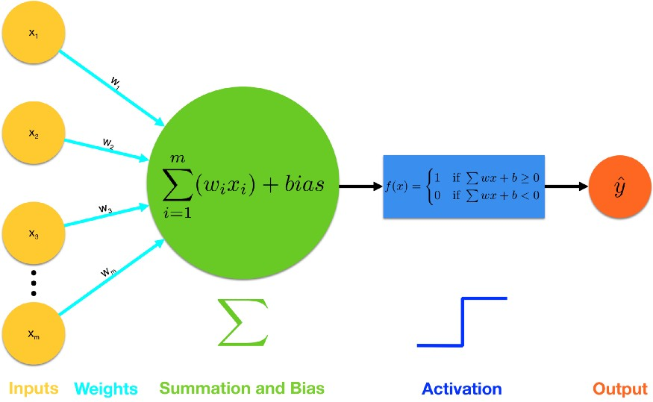
Perceptron: The Building Block
Inputs are fed into the perceptron
Weights are multiplied to each input
Summation and then add bias
Activation function is applied. Note that here we use a step function, but there are other more sophisticated activation functions like sigmoid, hyperbolic tangent (tanh), rectifier (relu) and more.
Output is either triggered as 1, or not, as 0.
https://towardsdatascience.com/introducing-deep-learning-and-neural-networks-deep-learning-for-rookies-1-bd68f9cf5883

Slide 6


How does Perceptron mimic human neurons?
W₁, W₂, & W₃ are Weights
_{Bias}
X₁
W₁
Neuron
X₁, X₂, & X₃ are numerical inputs
Y
X₂
W₂
W₃
$$Output$$
$$y=\sum_{i=1}^{3}{W_{i}X_{i}+bias}$$
X₃
$$\sum_{i=1}^{3}{W_{i}X_{i}}$$

Slide 7
What if we want the Perceptron’s output to be within a specific range i.e. 0 & 1?
X₁
W₁
Neuron
Bias
Different kinds of activation functions:
Hyperbolic Tangent: used to output a number from -1 to 1.
Logistic Function: used to output a number from 0 to 1.
X₂
W₂
a()
Y
W₃
Activation Function
X₃
An activation function is a function that converts the input given (the input, in this case, would be the weighted sum and the bias) into a certain output based on a set of rules.

Slide 8
A perceptron without activation function can only perform linear transformation on the inputs and hence it is less powerful…!

Slide 9
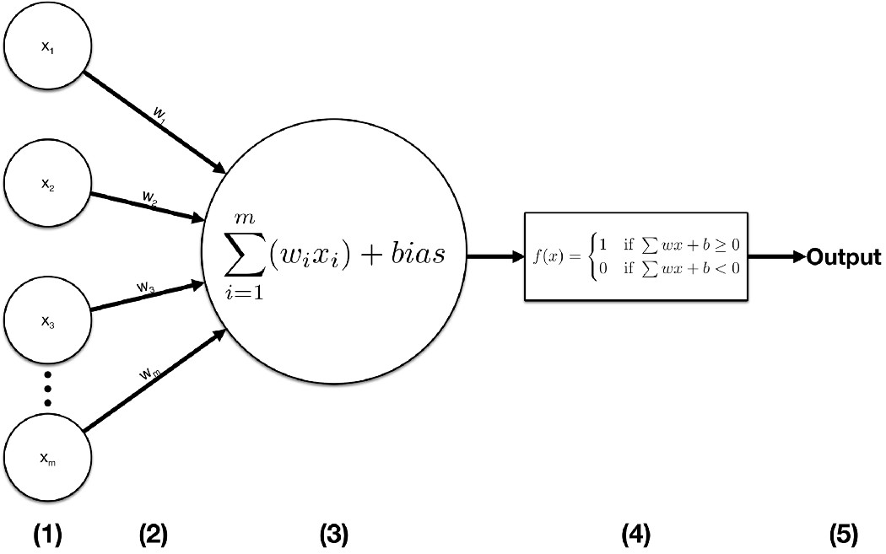
Perceptron: The Building Block
You need to decide whether to study DL or not.
If you will earn more money after mastering DL (Yes: 1, No: 0)
Is the relevant mathematics and programming easy (Yes: 1, No: 0)
You can work on DL immediately without the need for an expensive GPU (Yes: 1, No: 0)

Slide 10

Single Perceptron Learning
Assume that you actually want to learn deep learning-Desired Ouput

Slide 11
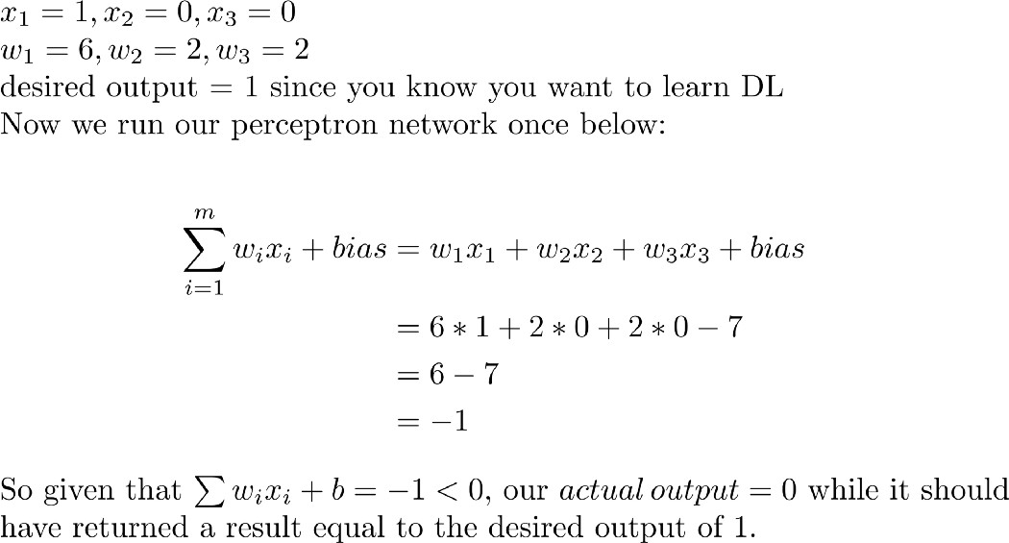
Single Perceptron Learning

Slide 12
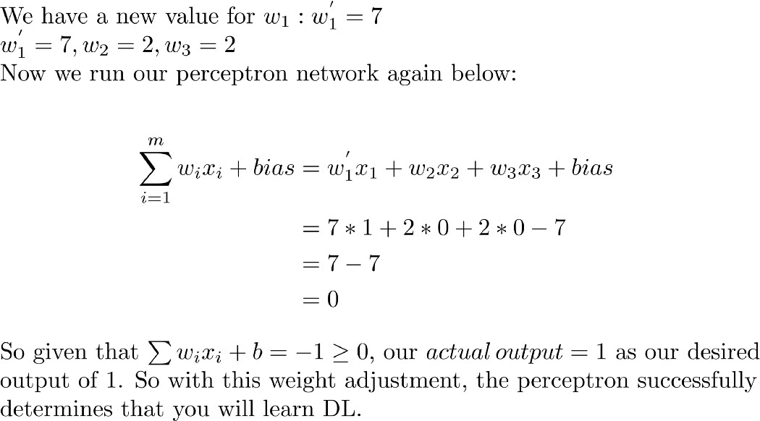
Single Perceptron Learning
Adjust the weights

Slide 13
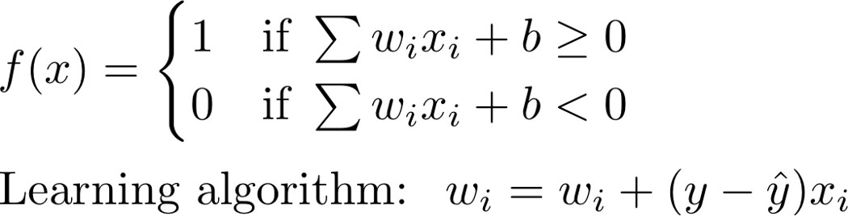
Single Perceptron Learning
Adjusting the weights: key to the learning process
Step Function

Slide 14
Single Perceptron Limitations
Can be used for binary classification problems
Limited to solving problems that are linearly separable.
It couldn’t represent the XOR gate, exclusive OR, where the gate only returns 1 if the inputs are different.
1969, Marvin Minsky and Seymour: Single perceptron can not be used for non-linear data.
https://www.science.org/doi/10.1126/science.165.3895.780
https://pythonmachinelearning.pro/perceptrons-the-first-neural-networks/
https://towardsdatascience.com/perceptron-algorithm-in-python-f3ac89d2e537

Slide 15
Neural Network: Applications and Types
Supervised Learning
Input | Output | Application
House Features | Price | Real Estate
Ad, Userinfo | Click on add?(0/1) | Online Advertising
Image | Object(1,2,……10000) | Photo Tagging
Audio | Text Transcript | Speech Recognition
English | Malayalam | Machine Translation
Video, Radar info | Position of the cars | Autonomous Car
Standard NN
CNN
RNN
Custom CNN
https://www.analyticsvidhya.com/blog/2021/05/a-comprehensive-tutorial-on-deep-learning-part-1/

Slide 16
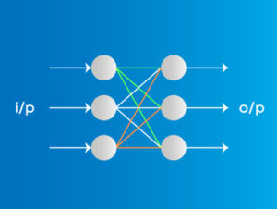
Types of Neural Networks
Feed Forward Neural Networks
The simplest form of neural networks.
Inputs are connected to Outputs
Input data travels in one direction
Weights are static here (Uni-directional)
Advantages
Less complex, easy to design & maintain
Fast and speedy [One-way propagation]
Highly responsive to noisy data
Disadvantages
Cannot be used for deep learning [due to absence of dense layers and back propagation]

Slide 17
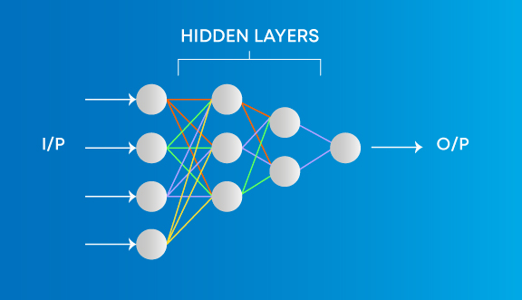
Types of Neural Networks
Multilayer Perceptron
The simplest form of neural networks.
Every single node is connected to all neurons in the next layer
Input and output layers are present having multiple hidden Layers
Advantages
Used for deep learning [due to the presence of dense fully connected layers and back propagation]
Disadvantages
Comparatively complex to design and maintain

Slide 18


Types of Neural Networks
Multilayer Perceptron: Applications

Slide 19
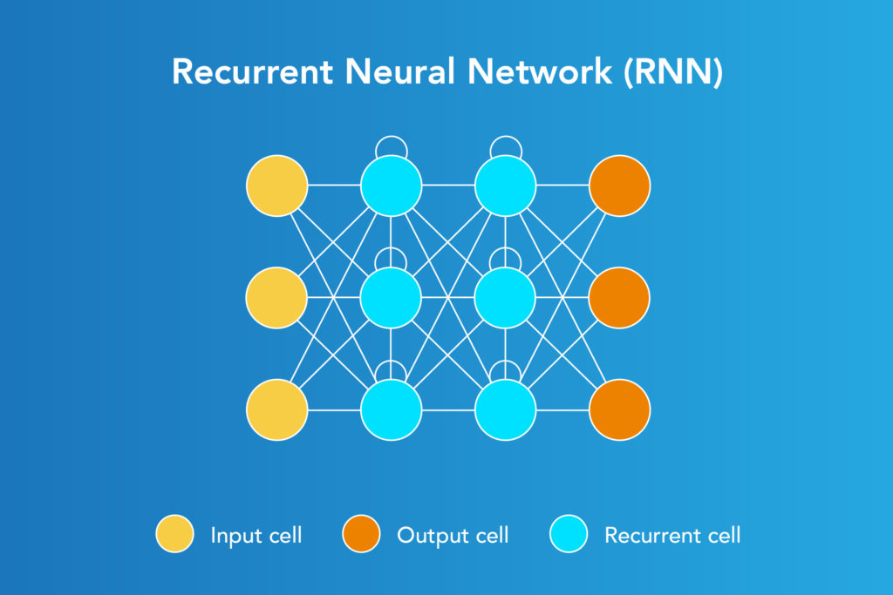


Types of Neural Networks
Recurrent Neural Networks
Designed to save the output of a layer.
Recurrent Neural Network is fed back to the input to help in predicting the outcome of the layer.

Slide 20
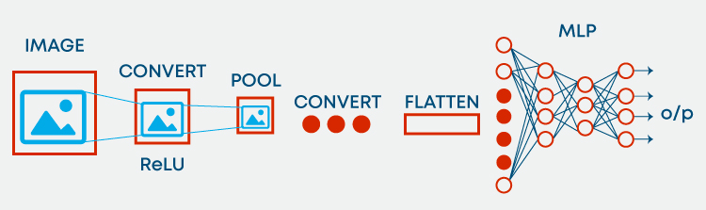
Types of Neural Networks
Convolutional Neural Network
Convolution neural network contains a three-dimensional arrangement of neurons.
Designed to solve Computer vision related problems.
Advantages
Used for deep learning with few parameters
Less parameters to learn as compared to fully connected layer
Disadvantages
Comparatively complex to design and maintain
Comparatively slow [depends on the number of hidden layers]

Slide 21
Thank you

